Slide 1
Introduction to Data Analysis

Slide 2
DATA INSIGHT FUNDAMENTALS
Patrick Boily Data Action Lab | uOttawa | Idlewyld Analytics
pboily@uottawa.ca
[with files from Jen Schellinck | Sysabee]

Slide 3

“Reports that say that something hasn't happened are always interesting to me, because as we know, there are known knowns; there are things we know that we know. There are known unknowns; that is to say, there are things that we now know we don't know. But there are also unknown unknowns – there are things we do not know we don't know.”
Donald Rumsfeld, US Department of Defense News Briefing, 2002

Slide 4
ANALYSIS PLAN OVERVIEW
[CDC, Creating an Analysis Plan]
Formulate research questions/hypotheses
Identify necessary (and available) datasets
Establish inclusion/exclusion criteria for records/observations
Select variables for use in the analyses
Chose statistical methods and software

Slide 5
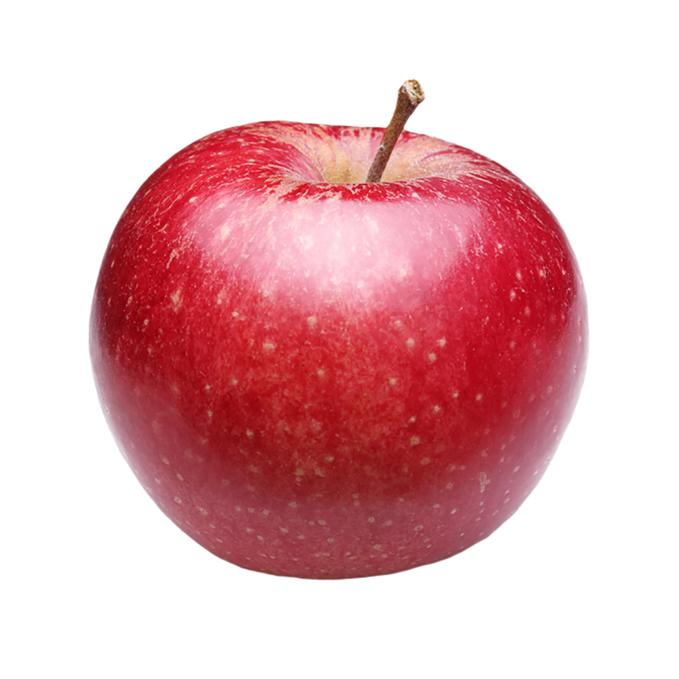
OBJECTS AND ATTRIBUTES
Object: apple
Shape: spherical
Colour: red
Function: food
Location: fridge
Owner: Jen
Remember: a person or an object is not simply the sum of its attributes!

Slide 6
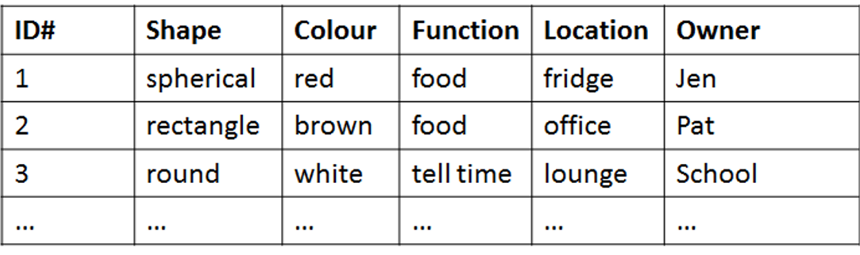
FROM ATTRIBUTES TO DATASETS
Attributes are fields (columns) in a database; objects are instances (rows).
Objects are described by their feature vector, the collection of attributes associated with value(s) of interest.

Slide 7
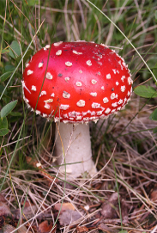
POISONOUS MUSHROOM DATASET
[https://archive.ics.uci.edu/ml/datasets/Mushroom]
Amanita muscaria
Habitat: woods Gill Size: narrow Odor: none Spores: white Cap Colour: red
Classification problem: Is Amanita muscaria edible, or poisonous?

Slide 8
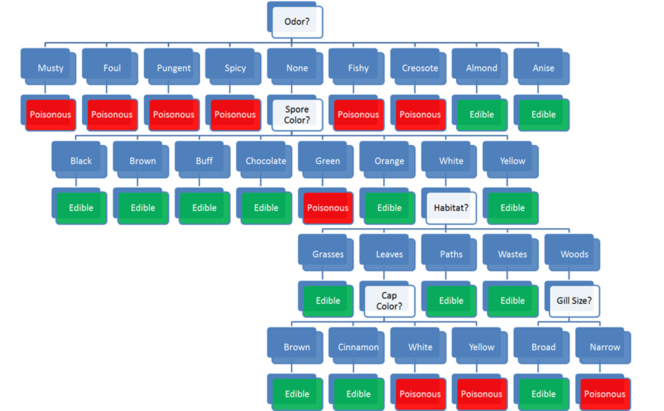
Habitat: woods
Gill Size: narrow
Odor: none
Spores: white
Cap Colour: red
Classification problem: edible or poisonous?

Slide 9
Habitat: woods
Gill Size: narrow
Odor: none
Spores: white
Cap Colour: red
Classification problem: edible or poisonous

Slide 10
ASKING THE RIGHT QUESTIONS
Data science is really about asking and answering questions:
Analytics: “How many clicks did this link get?”
Data Science: “Based on this user’s previous purchasing history, can I predict what links they will click on the next time they access the site?”
Data mining/science models are usually predictive (not explanatory): they show connections, but don't reveal why these exist.
Warning: not every situation calls for data science, artificial intelligence, machine learning, statistics, or analytics.

Slide 11
THE WRONG QUESTIONS
Too often, analysts are asking the wrong questions:
questions that are too broad or too narrow
questions that no amount of data could ever answer
questions for which data cannot reasonably be obtained
The best-case scenario is that stakeholders will recognize the answers as irrelevant.
The worst-case scenario is that they will erroneously implement policies or make decisions based on answers that have not been identified as misleading and/or useless.

Slide 12
WHAT IS DATA ANALYSIS?
Finding patterns in data
Using data to do something (answer a question, assist in decision-making, predict a future occurrence, draw a conclusion)
Creating models of the data
Describing or explaining a situation (the system)
(Testing (scientific) hypotheses?)
(Carrying out calculations on data?)

Slide 13
WHAT IS DATA SCIENCE?
Data science is the collection of processes by which we extract useful and actionable insights from data.
T. Kwartler (paraphrased)
Data science is the working intersection of statistics, engineering, computer science, domain expertise, and “hacking.” It involves two main thrusts: analytics (counting things) and inventing new techniques to draw insights from data.
H. Mason (paraphrased)

Slide 14
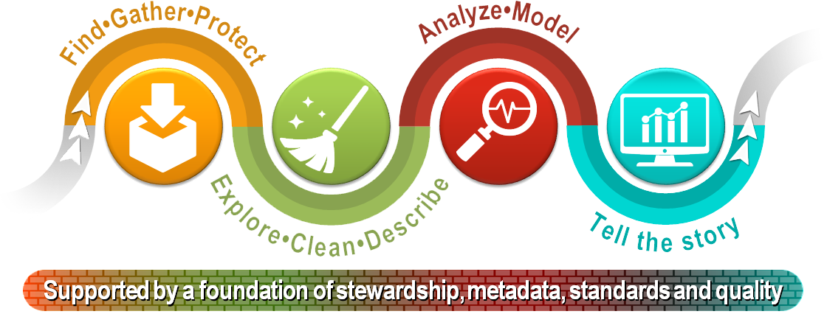
[StatCan, Steps of the Data Journey]

Slide 15
[J. Schellinck]

Slide 16
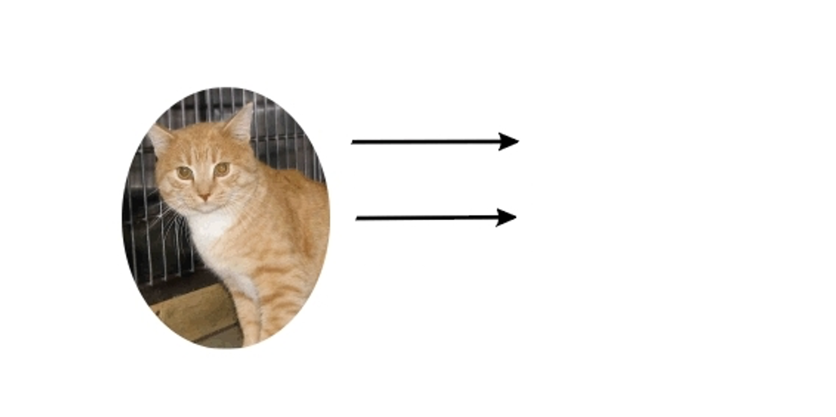
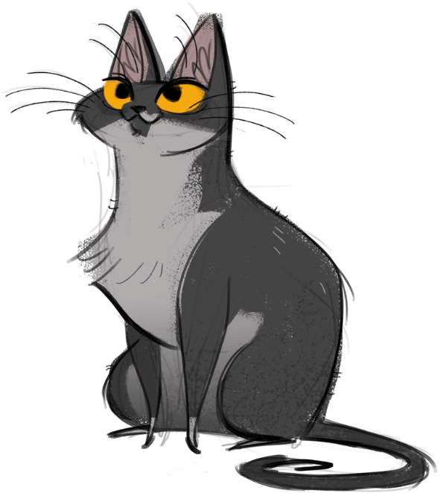
[http://dailycatdrawings.tumblr.com; #309]
Real World
Model
Theory
Identification of details relevant to description and translation of real-world objects into model variables

Slide 17
TAKE-AWAYS
Systems can approximate certain aspects of the Universe.
System models provide the basis under which data is identified and collected, but data itself is approximate and selective.
Knowledge gaps happen – be ready to re-visit your set-up regularly.
Implicit conceptual modeling can lead to problematic situations.
If the data, the system, and the world are out of alignment, data analysis insights might ultimately prove useless.

Slide 18
WHAT ARE ETHICS?
Broadly speaking, ethics refers to the study and definition of right and wrong conducts:
“not […] social convention, religious beliefs, or laws”. (R.W. Paul, L. Elder)
Influential ethical theories:
Kant's golden rule (do onto others…), consequentialism (the ends justify the means), utilitarianism (act in order to maximize positive effect), etc.
Confucianism, Taoism, Buddhism (?), etc.
Ubuntu, Maori, etc.

Slide 19
ETHICS IN THE DATA CONTEXT
[University of Virginia, Centre for Big Data Ethics, Law, and Policy]
Data ethics questions:
Who, if anyone, owns data?
Are there limits to how data can be used?
Are there value-biases built into certain analytics?
Are there categories that should not be used in analyzing personal data?
Should some data be publicly available to all researchers?
Analytically, the general is preferred to the anecdotal – decisions made on the basis of machine learning and A.I. (security, financial, marketing, etc.) may affect real beings in unpredictable ways.

Slide 20
BEST PRACTICES
“Do No Harm”: data collected from an individual should not be used to harm the individual.
Informed Consent:
Individuals must agree to the collection and use of their data
Individuals must have a real understanding of what they are consenting to, and of possible consequences for them and others
Respect “Privacy”: excessively hard to maintain in the age of constant trawling of the Internet for personal data.

Slide 21
BEST PRACTICES
[More information on how to consider data privacy and human rights is found in the Intranet Data Wiki.]
Keep Data Public: data should be kept public (all? most? any?).
Opt-In/Opt-Out: Informed consent requires the ability to opt out.
Anonymize Data: removal of id fields from data prior to analysis.
“Let the Data Speak”:
no cherry picking
importance of validation (more on this later)
correlation and causation (more on this later, too)
repeatability

